Slide 1
IBM University Engagement Project Submission
“Exploring the Power of Agentic AI with IBM Granite and LangFlow”

Slide 2
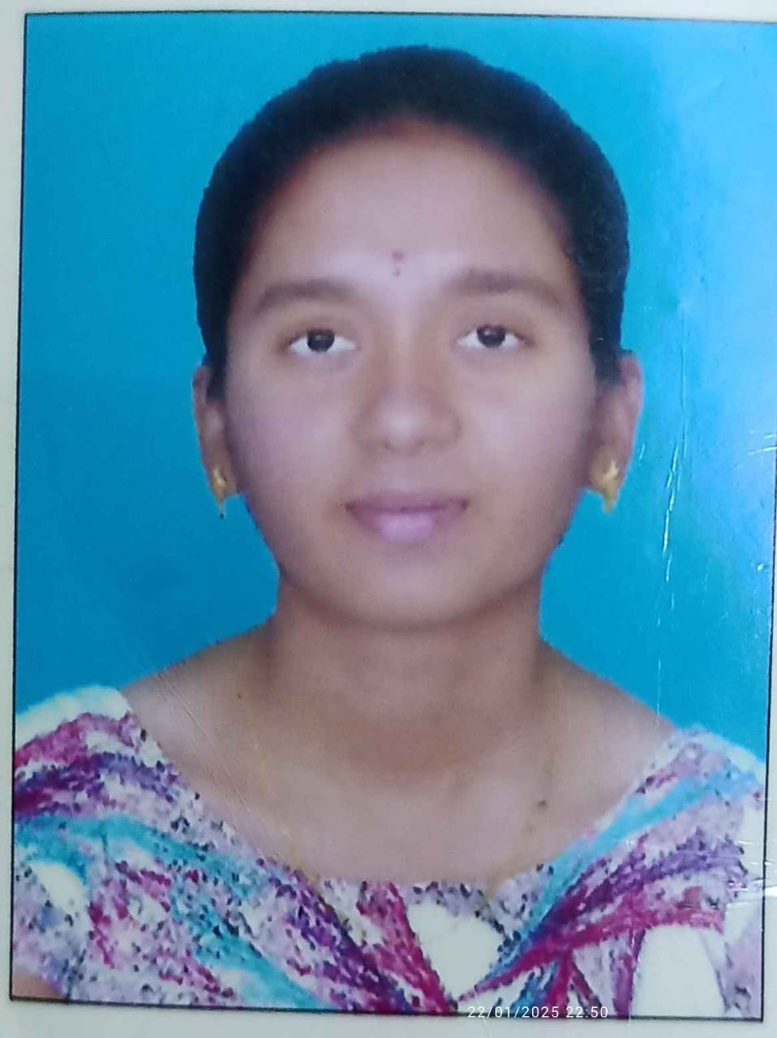
Project Tile – [Predicting NSAP Beneficiary Counts using Machine Learning]
Domain of Project – [Social Welfare]
Student Name | Recent Passport Photo | Email ID | Mobile number [WhatsApp]
B.Tejasri |  | baletejasri@gmail.com | 8555038961

Slide 3
Problem Statement -
Problem Statement :NSAP Eligibility Prediction using Machine Learning
The Challenge
Manual verification of NSAP applicants is slow and error-prone, causing delays in pension scheme allocation.
Objective: Build an ML-based system to predict the most suitable NSAP scheme for an applicant using demographic and socio-economic data.
Features
Eligibility prediction for NSAP schemes.
Automated applicant classification.
District/state-wise beneficiary analysis.
Gender and social-category insights (SC/ST/OBC).
Visualization dashboard with scheme distribution and model performance.
Domain
Social Welfare & Government Services
Technology
IBM Cloud Lite, IBM Watson Studio, Python, Pandas, Scikit-learn, IBM Cloud Object Storage

Slide 4
Technology Used
Python
IBM watsonx.ai
Generative AI
Retrieval-Augmented Generation (RAG)
Machine Learning
Natural Language Processing (NLP)
Computer Vision
Streamlit
Pandas & NumPy
IBM Cloud

Slide 5
Proposed Solution -
Develop an AI-powered Nutrition Agent that uses a multi-agent architecture to provide personalized diet recommendations, nutritional analysis, and preventive health guidance. The system retrieves reliable nutrition data using RAG, generates customized meal plans based on user preferences and health conditions, analyzes food logs from text, image, or voice inputs, and offers health-focused dietary suggestions. An interactive dashboard tracks daily and weekly nutrient intake, deficiencies, and progress toward fitness and wellness goals.

Slide 6
Langflow component Used -
Chat Input
Prompt Template
LLM (IBM watsonx.ai Model)
RAG / Retriever Component
Vector Store
Text Splitter
Document Loader
Agent Component
Output Parser
Chat Output
API Request Component
Memory Component

Slide 7
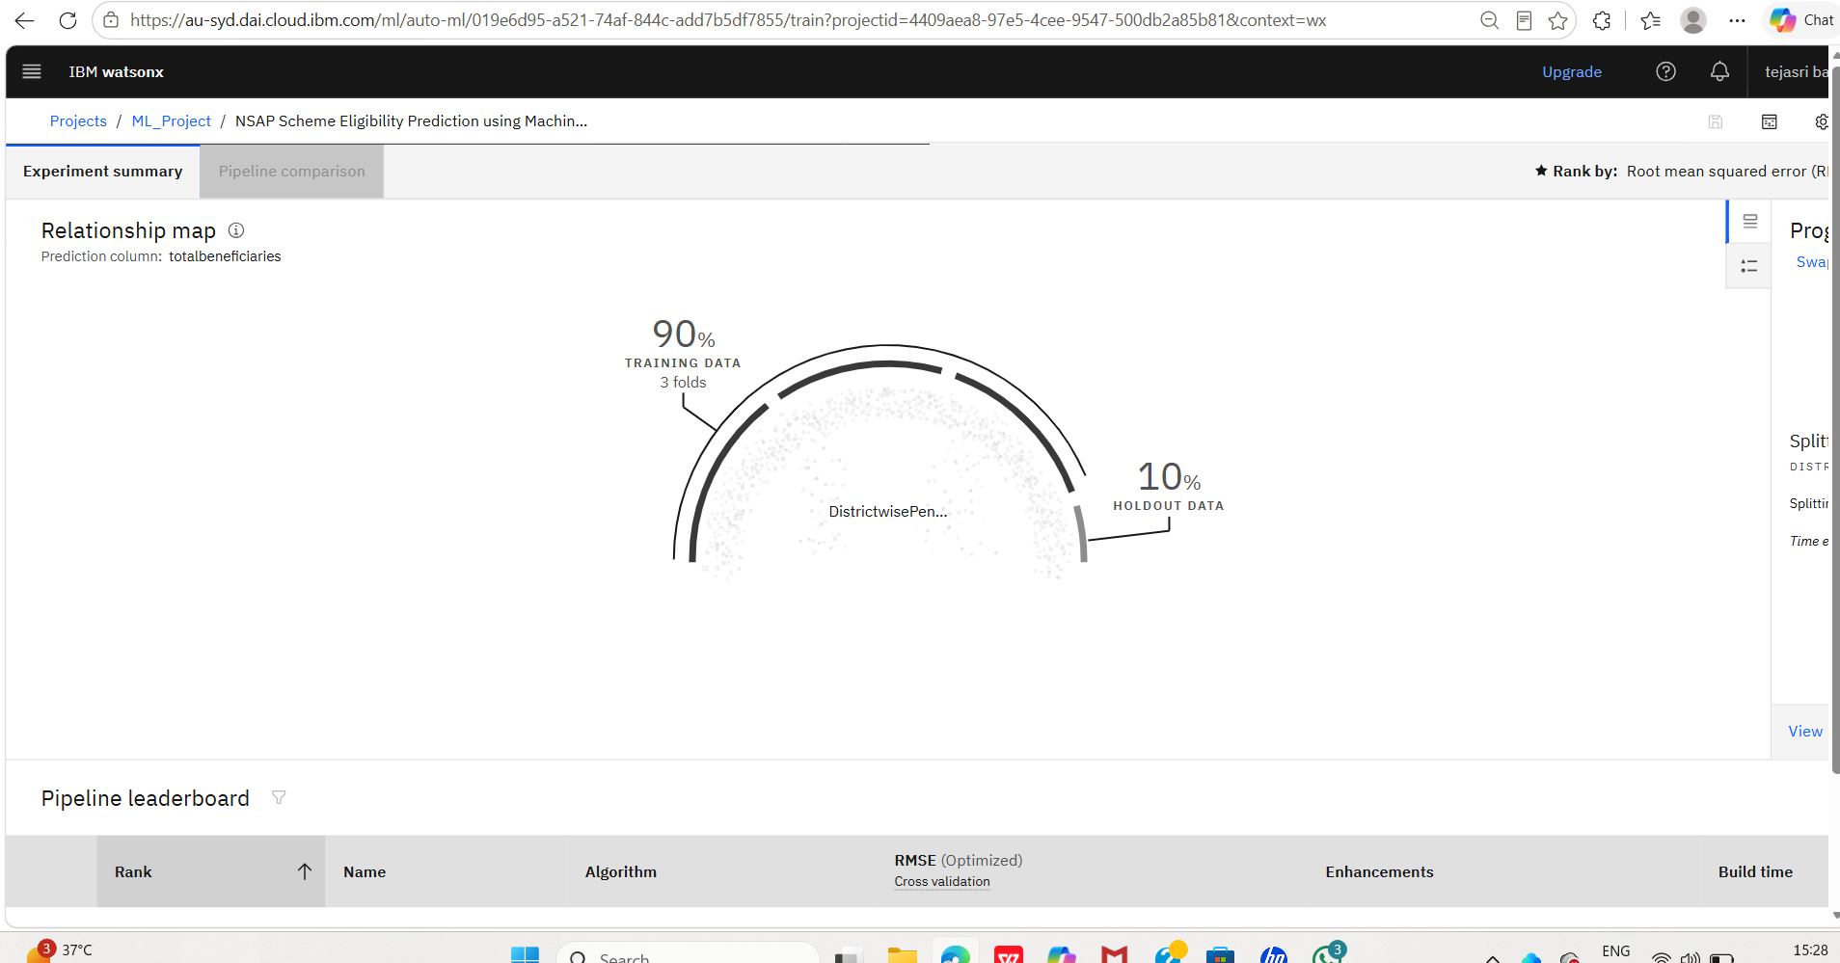
Langflow workflow -

Slide 8
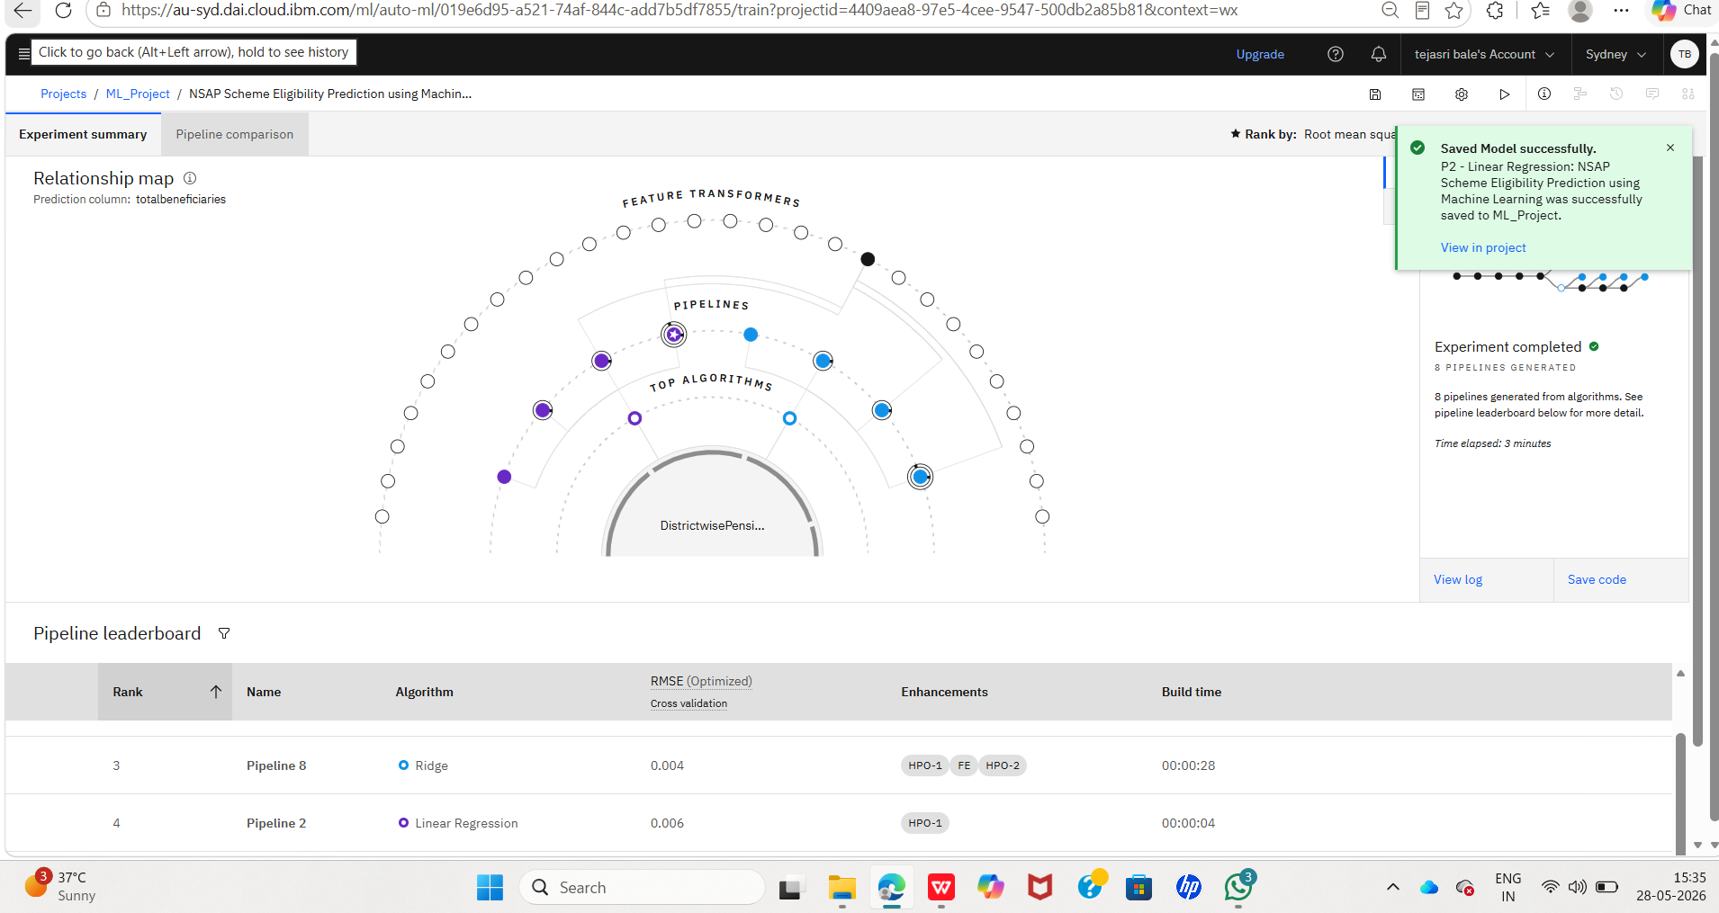
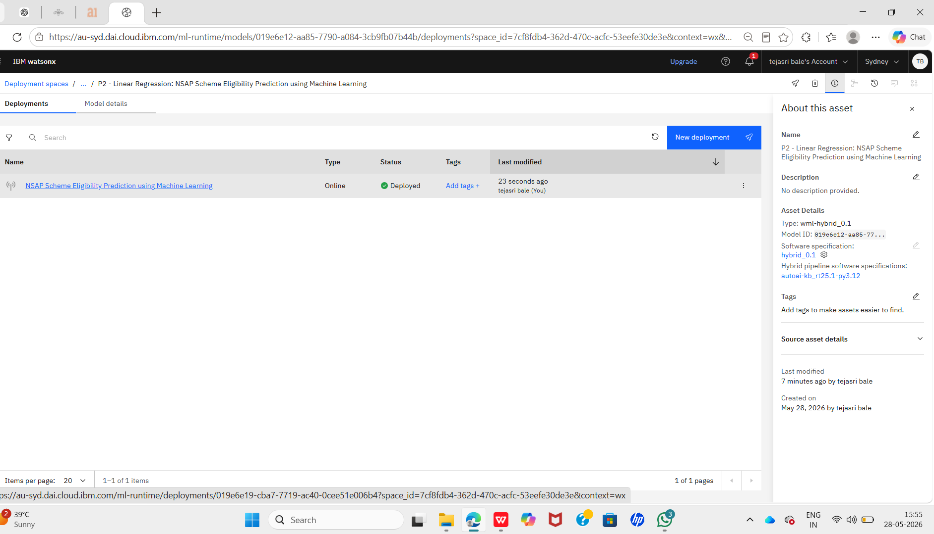
Architecture blueprint

Slide 9

Role of Agentic AI in the solution
Agentic AI enables the Nutrition Agent to autonomously perform specialized tasks through multiple intelligent agents working together. Each agent has a specific responsibility:
Nutrition Knowledge Agent – Retrieves accurate nutritional information from trusted sources using RAG.
Diet Recommendation Agent – Creates personalized meal plans based on age, health conditions, allergies, preferences, and fitness goals.
Health Advisory Agent – Provides preventive health recommendations and disease-specific dietary guidance.
Food Log & Feedback Agent – Analyzes meals entered through text, images, or voice and gives instant nutritional feedback.
By coordinating these agents, the system delivers personalized, accurate, and real-time nutrition guidance, improving diet management and supporting healthier lifestyle choices.

Slide 10
Technology Used
Python
IBM watsonx.ai
Agentic AI
Generative AI
Retrieval-Augmented Generation (RAG)
Machine Learning
Natural Language Processing (NLP)
Computer Vision
Langflow
Streamlit

Slide 11
Git Hub Link
https://github.com/Tejasribale/NSAP-Eligibility-Prediction
·
·
·

Slide 12
Novelty and Uniqueness
The proposed Nutrition Agent combines Agentic AI, Generative AI, and RAG to deliver highly personalized and real-time nutrition guidance. Unlike traditional diet applications, it uses a multi-agent architecture where specialized agents collaborate to retrieve nutritional knowledge, generate customized meal plans, analyze food intake, and provide preventive health recommendations. The system supports text, image, and voice-based food logging, offers disease-specific dietary guidance, and visualizes nutrient intake through an interactive dashboard, making nutrition management more intelligent, accurate, and user-centric.

Slide 13
Future Scope
Integration with wearable devices and fitness trackers for real-time health monitoring.
AI-based calorie estimation from food images with higher accuracy.
Personalized nutrition recommendations using medical records and health reports.
Support for multiple regional languages to improve accessibility.
Real-time diet coaching through voice assistants and chatbots.
·
·
·

